Slide 1

Passive Explorer -5
Team DADAC
FLL 2024 Innovation Project

Slide 2
Story of the PX-5
We’re Team DADAC!
In this year's FLL SUBMERGED innovation project, we're diving deeper into ocean exploration. Inspired by the challenges of water pressure in the depths, we've designed an Autonomous Underwater Vehicle (AUV) - the PX-5(Passive eXplorer 5) - that uses this pressure in an advantageous way. The pressure is no longer the explorer’s enemy[1], it is now a powerful ally!
Introducing the PX-5
The PX-5 builds on the Slocum Glider design, with a spring-loaded Origami tail ballast tank that collapses under deep-sea pressure and re-inflates near the surface. This innovative design eliminates the need for battery-powered buoyancy adjustments. With deep-sea pressure as our ally, the door to extremely long deep ocean exploration missions is open!

Slide 3
Schematic of the PX-5
Wings to turn sinking motion into forward glide
Spring loaded Collapsible Origami Tail with latch
Air/Compressible Gas Bubble for buoyant control
Front Ballast Tank
Connecting pipe

Slide 4
Passive EXPlorer - 5 JOURNEY TO THE DEPTHS
Uncompressed state
Glider path as nose pitches up and down due to passive changes in buoyancy
Nose is heavier - glider pitches downward
Compressed state
We control the dive on adjusting the stiffness of the spring and the point at which the spring latch engages or disengages.
Tail is heavier - glider pitches upward

Slide 5
How does the PX-5 Work?
The PX-5 performs its mission by repeatedly ascending and descending in the water. To better understand how our spring-loaded Origami tail bladder propels the PX-5, let’s examine a single dive comprising a descent and ascent.
Descent of the PX-5
The journey begins at the surface with the tail bladder fully inflated. Water fills the front ballast tank, making the nose heavier and initiating a nose-first descent. Similar to other Slocum gliders, the flow of water over the wings translates the downward motion into forward movement. As the PX-5 sinks, external pressure increases, eventually compressing the spring and causing the Origami tail bladder to crumple. The air from the tail bladder transfers to the front ballast, pushing out water and slowing down the descent rate. When the spring reaches maximum compression, a latch engages holding it in place. Enough air is transferred to make the nose lighter, starting the PX-5's ascent.
Ascent of the PX-5
The PX-5 begins to float upward. The continued flow of water over the wings propels it forward while the external pressure decreases. Nearing the surface, the spring latch disengages, re-inflating the Origami tail bladder. This causes air to be drawn back into the bladder from the front ballast, with water slowly refilling the front ballast. As the ascent rate slows, the PX-5 levels out near the surface. The cycle then repeats, with the front ballast water making the nose heavier and initiating a new descent.

Slide 6
Origami Tail Ballast tank Turns Pressure Into an ALLY
Why Origami?
Good volume compression per area.
Other ideas were used in different designs - (not passive).
Advantages over other designs
Use even less power → longer endurance than existing glider designs.
Lower complexity and cost.
Lighter as it doesn’t need a heavy counter weight or a very big battery (to operate a pump).
Potential for opportunistic generation of electricity
a small turbine on the wings may be enough to recharge the battery during descent.

Slide 7
What did we LEARN?
Innovation is difficult. There are a lot of people working on the same kind of ideas.
We learnt how a simple design can change an engineering challenge into a mechanical advantage.
Changing your design’s enemy into an ally, opens the doors to something way beyond what is thought possible.

Slide 8
What Were the CHallenges?
Finding a reliable way to turn the water pressure into a mechanical advantage.
Discussed several ideas during brainstorming sessions before settling on the design.
Constructing the model of the collapsible origami tail ballast tank from YouTube videos.
We were able to do this because of the linguistic strengths of the team.
Finding a set of materials that could be used to construct a real collapsible origami tail ballast tank.
We had difficulty knowing what would work in marine conditions.

Slide 9
Materials and Structure for the PX-5
Deployable-Collapsible Frame (like an umbrella)
We use a lightweight frame made of Ni-Ti Alloy which can collapse or deploy upon need. Frame will be covered by a fabric which may be Armadillo Skin CRFP or Hybrid Weave.
“Armadillo Skin” CRFP
Carbon Fiber Reinforced Polymer(CRFP) with Ni-Ti Alloy plates glued on. The “Armadillo Skin” that can fold in the Origami fashion. The “Armadillo Skin” will allow the structure be flexible around the frame but rigid in the spaces between the frame.
Hybrid Weave
We weave the fabric forming the Origami bladder with parts that are flexible at the bendy parts, and then really dense in the rigid parts. We change the choice of fiber blends and weaves used in the different parts of the Origami surface to achieve control over the flexibility and rigidity.
Additionally, we may use coating with the fabric to manage exposure from the marine environment (salt, biofouling, air-tightness).

Slide 10
How did we break UP the Work?
Deek - came up with the passive buoyancy control idea and the spring loading idea,
Alex - build model - build the hull and the wings,
Daon - build model - origami tail,
Abyan - came up with real world materials that the PX-5 could be built from,
Calvin - came up with using an origami bladder. Making the poster.

Slide 11
Summary of our Project
Identify Problem: Deep sea pressures limit exploration [1,2].
Design: Conducted several brainstorming sessions and identified a new design for the AUV.
Create: Made drawings and a model out of recycled materials
Iterate: Conducted a critical review to identify design deficiencies and tried to fix them.
Communicate: Made a slide deck and practised our talk.
[1] Improved technologies make deeper dives for submergence vessels possible - ASME
[2] https://www.toppr.com/guides/physics-formulas/water-pressure-formula/

Slide 12
Thank You For Listening!

Slide 13
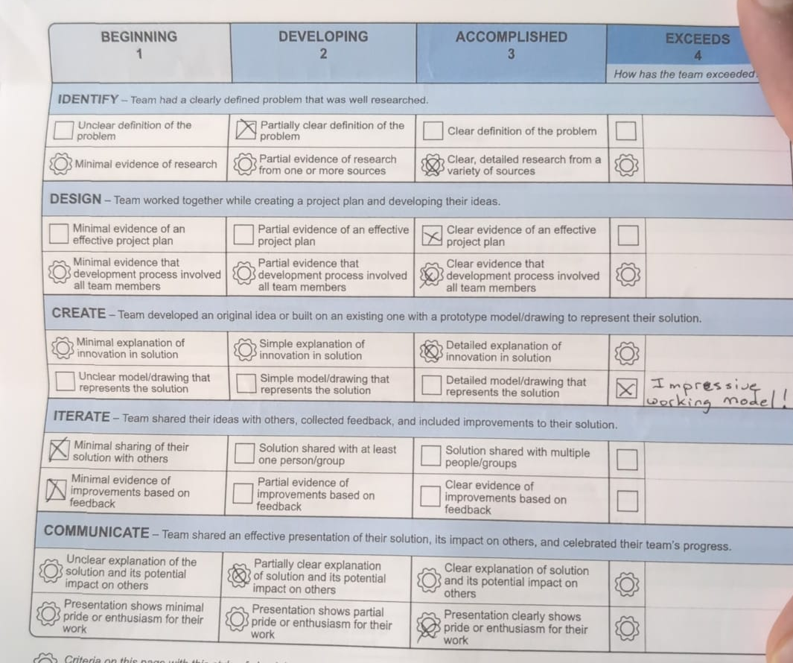
Judges Reports

Slide 14
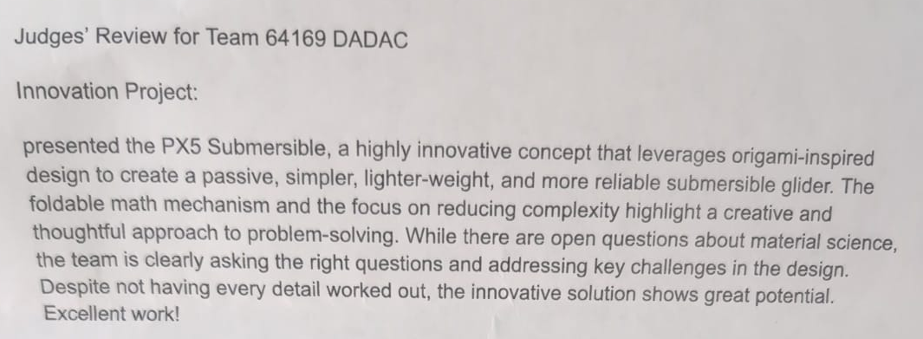
Judges Reports

Slide 15
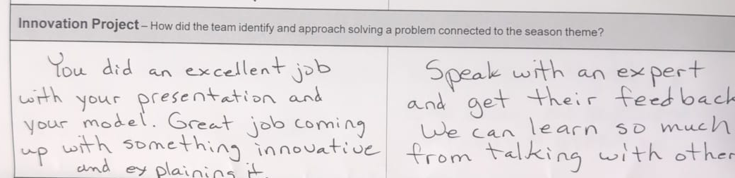
Judges Reports

Slide 16
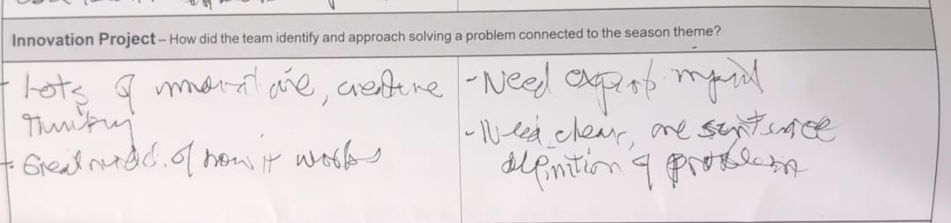
Judges Reports

